Slide 1
Employee Data Analysis using Excel
STUDENT NAME: RAMYA P
REGISTER NO:312209342
DEPARTMENT:PG AND RESEARCH DEPARTMENT OF COMMERCE
COLLEGE: ANNA ADARSH COLLEGE FOR WOMEN

Slide 2
PROJECT TITLE
Employee Performance Analysis using Excel

Slide 3


AGENDA
Problem Statement
Project Overview
End Users
Our Solution and Proposition
Dataset Description
Modelling Approach
Results and Discussion
Conclusion
3/21/2024 Annual Review

Slide 4

PROBLEM STATEMENT
To analyze and evaluate the performance of employees within an organization over a specific period using Excel. The goal is to identify high performers, average performers, and employees who may need improvement, based on key performance indicators (KPIs).

Slide 5

PROJECT OVERVIEW
.
An employee data project using Excel typically involves organizing, analyzing, and visualizing employee information for better management and decision-making.

Slide 6

WHO ARE THE END USERS?
EMPLOYERS
EMPLOYEE
ORGANZIATION

Slide 7

OUR SOLUTION AND ITS VALUE PROPOSITION
Filtering : To find the missing.
Data Chart : To get an graphical representation.
Pivot table : To summarize the data Conditional. .
Technique : Used to identify the missing data

Slide 8
Dataset Description
Employee dataset : Kaggle
Total : 26
Feature Used : 9 features
Employee id
First name
Last name
Business unit
Gender
Performance score
Current employee rating
Performance level

Slide 9

THE "WOW" IN OUR SOLUTION
Formula : “=IFS(Z2>=5,"VERY HIGH",Z2>=4,"HIGH",Z2>=3,"MEDIUM","TRUE","LOW")”
This formula is used to find the performance level of the employees which is derived as “medium , low and high” . And this performance level is used to get an graphical representation of the employees performance.
CONDITIONAL FORMATTING :
The conditional formatting is used to identify the missing data in a cell , highlight the missing cells and also to remove the missing cell
3/21/2024 Annual Review
9

Slide 10
MODELLING
DATA SCREENING : Downloaded an employee dataset from Kaggle , and saved the dataset in an folder then inserted the same in excel .
DATA CLEANING : Using conditional formatting from home identified and removed the missing data and selected 9 data from the data set like (emp id , name , gender etc).
DATA FORMULATING : Using “IFS” condition created an column of performance level using data from current employee rating which gave an output as medium , low , high.
PIVOT TABLE CREATION : Select pivot table from insert and an pivot table is enabled , now select the required data. An pivot table is now created , We can also create pivot table through Queries and Connection icon.
GRAPHICAL REPRESENTATION : After creating an pivot table select the pivot table and go to insert icon and select recommendation chart and an visual representation is created .
10

Slide 11
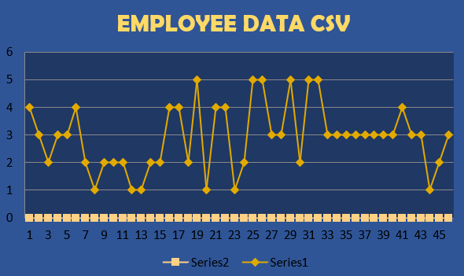
RESULTS
11

Slide 12
Conclusion
The end output is created as employee performance analyses using various functions such as pivot table , graph etc . This helps to easily analyse the data . This performance analysis is used to find the employees with greater efficiency

